Slide 1
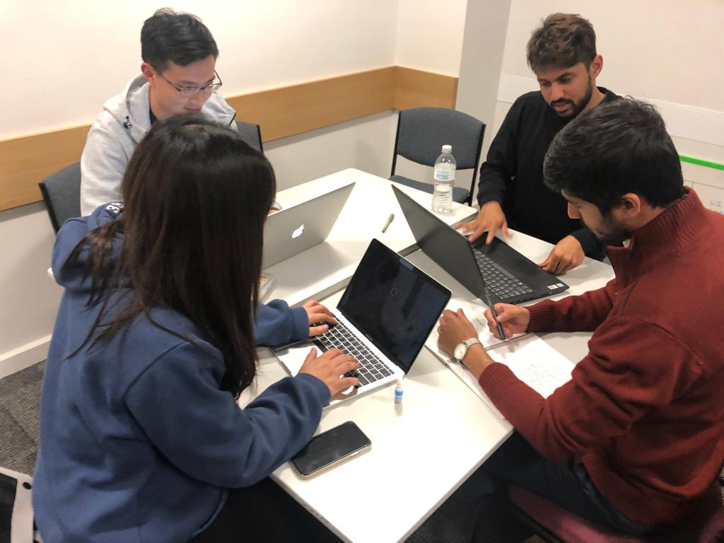
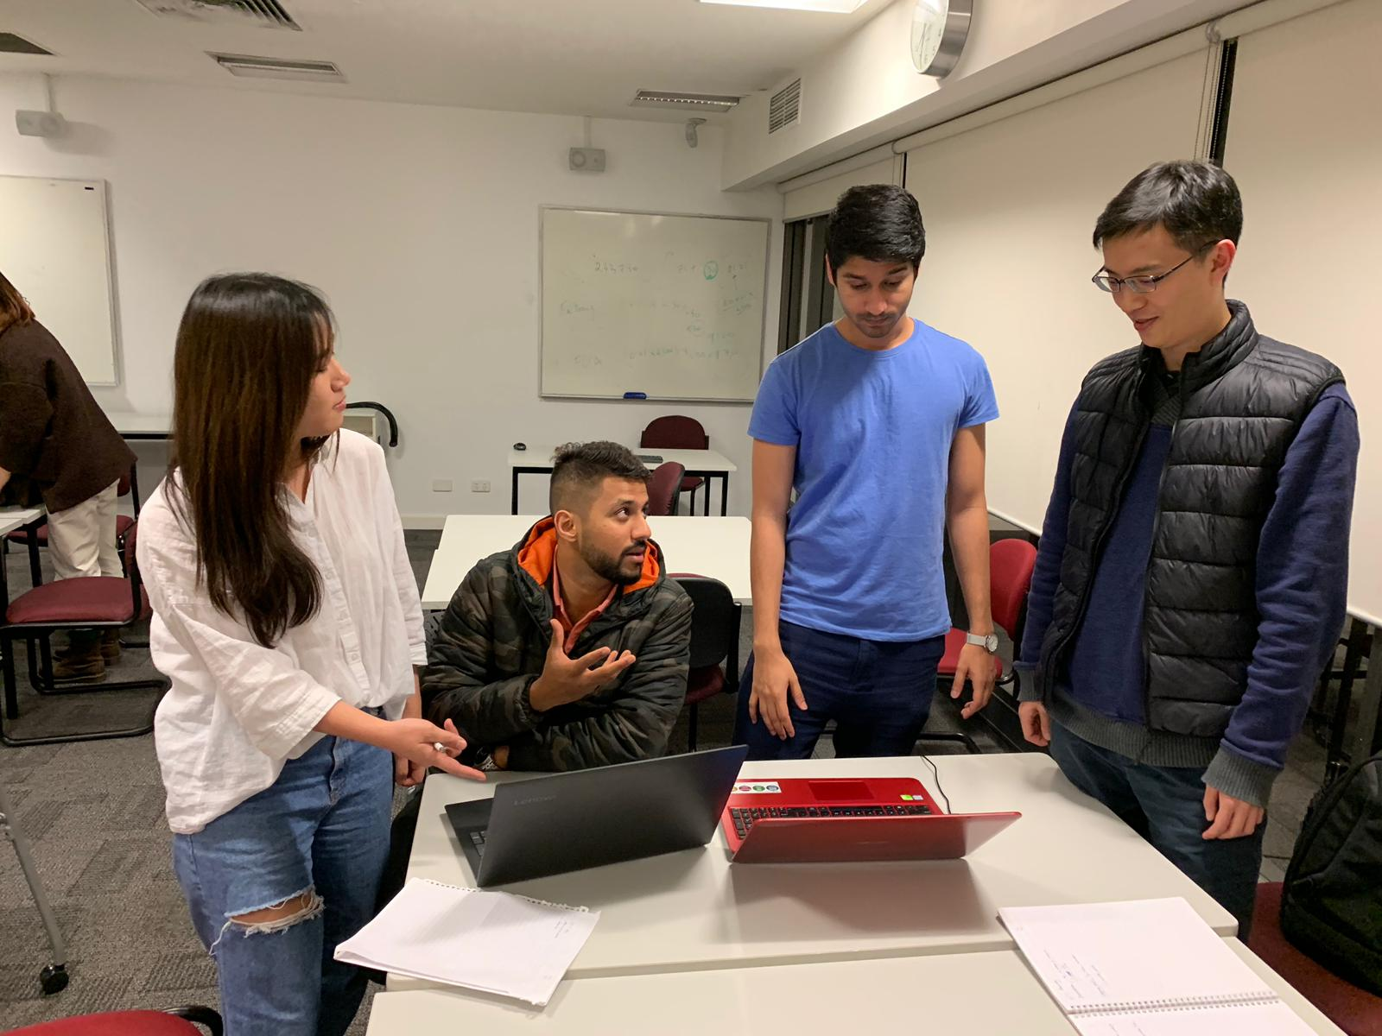
TABLE
PARENTING-HELP
59
www.parenting-help.ml
SUPPORTING NEW AUSTRALIANS, PARENTING-HELP
https://www.parenting-help.ml/
Notes:
Create 3 slides (You do not do presentation for these, these slide will be displayed as kiosk mode during your expo)
No. is your Table number
You must follow the style mentioned in this page, do not change the heading layout (Include the alignment and link color)
Example of link: https://hhhh.xx/
You decide where to put things in the body, Please think about what do you need to consider?
Slides shall include pictures of team working (not just smiley faces and finger signs)
Picture or pictures of your applications, pictures of your target audience, anything you consider will make an impression
Description in 3 – 4 sentence of what your app does
Your mentors will check this power point
If you do not follow the requirement, you and your team will be asked to redo
No animations/ Transition inside the slide

Slide 2
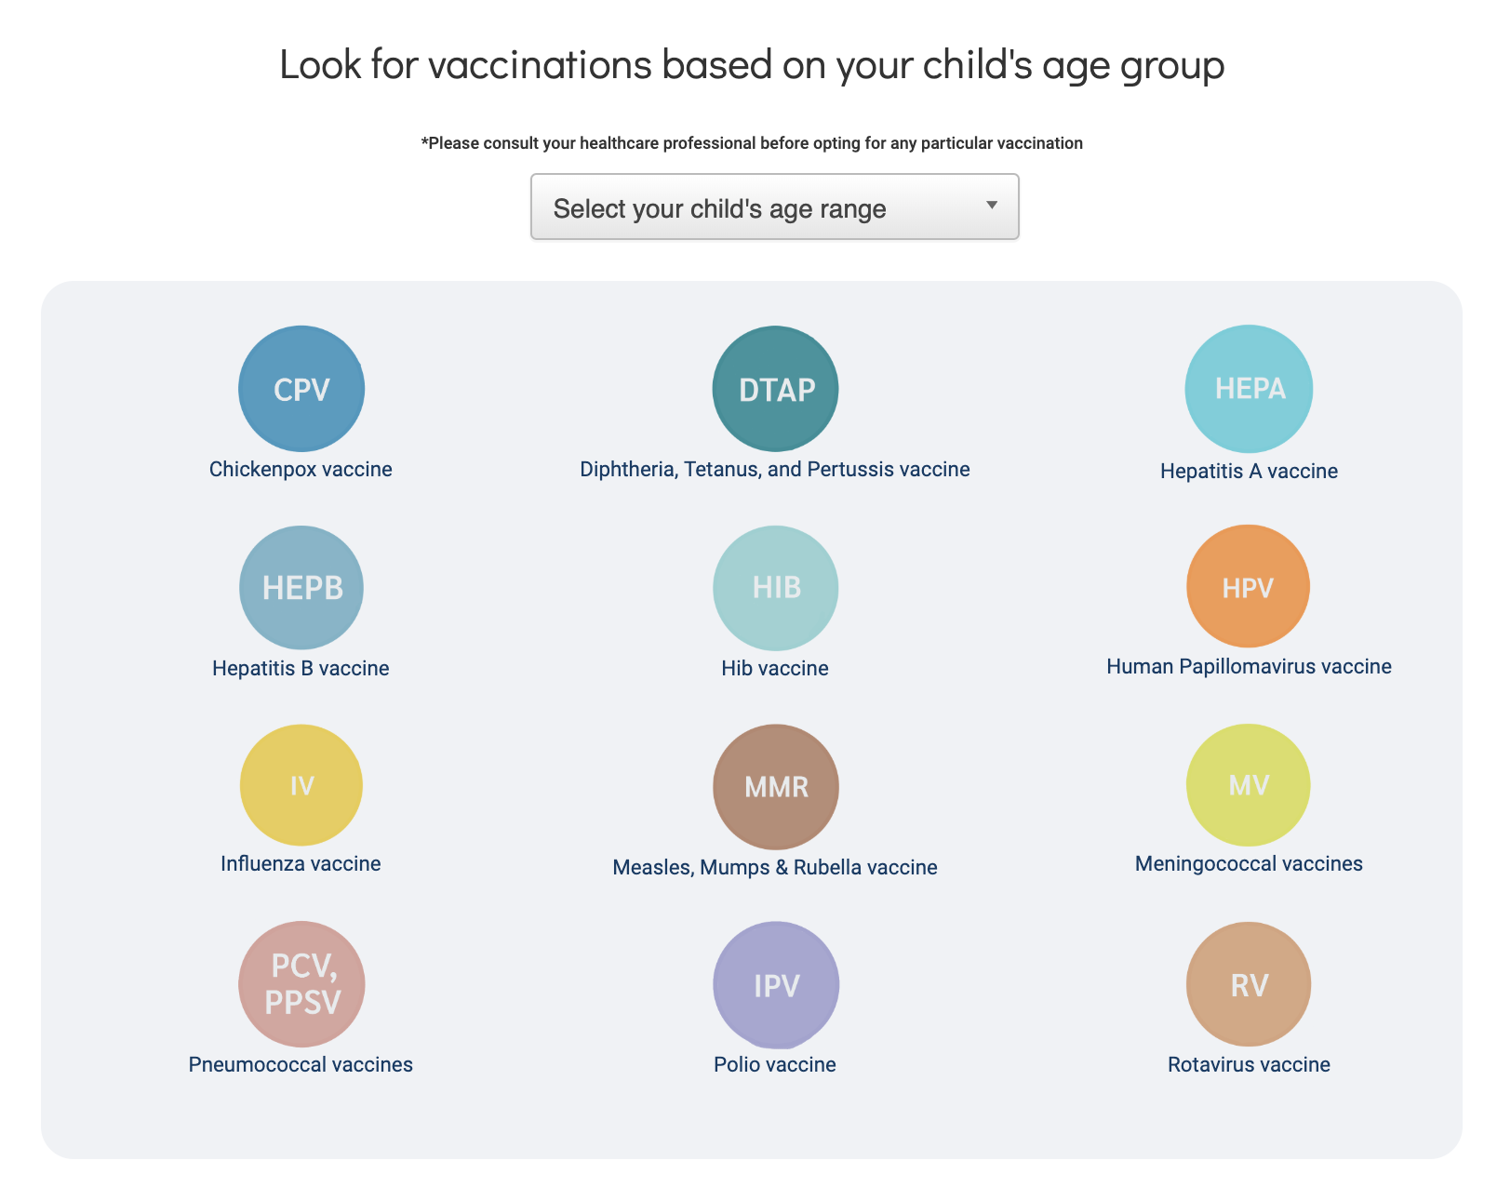
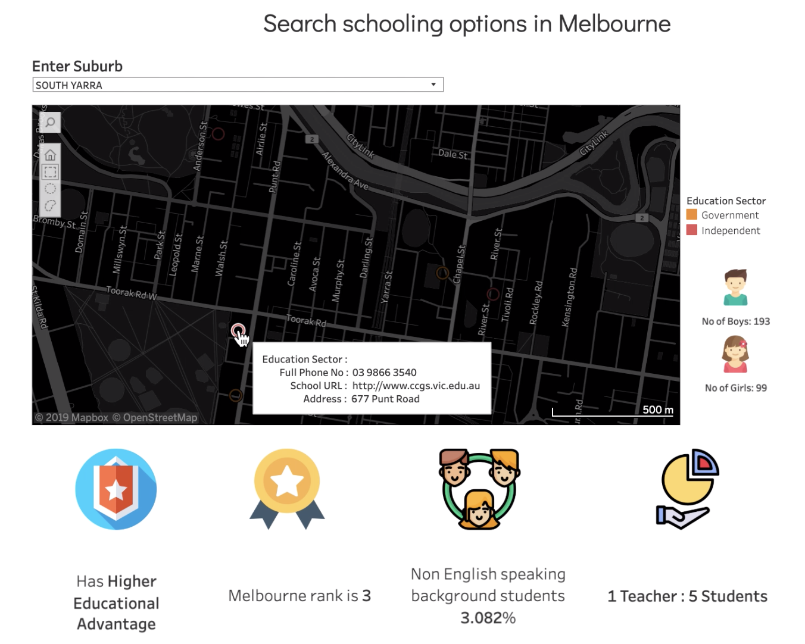
TABLE
PARENTING-HELP
59
www.parenting-help.ml
SUPPORTING NEW AUSTRALIANS, PARENTING-HELP
Parenting is hard, even harder when you are in a new country.
We answer What , Where and Why:
Child Care & Vaccination | Schooling | Sports
https://www.parenting-help.ml/
Notes:
Create 3 slides (You do not do presentation for these, these slide will be displayed as kiosk mode during your expo)
No. is your Table number
You must follow the style mentioned in this page, do not change the heading layout (Include the alignment and link color)
Example of link: https://hhhh.xx/
You decide where to put things in the body, Please think about what do you need to consider?
Slides shall include pictures of team working (not just smiley faces and finger signs)
Picture or pictures of your applications, pictures of your target audience, anything you consider will make an impression
Description in 3 – 4 sentence of what your app does
Your mentors will check this power point
If you do not follow the requirement, you and your team will be asked to redo
No animations/ Transition inside the slide

Slide 3
TABLE
PARENTING-HELP
59
www.parenting-help.ml
SUPPORTING NEW AUSTRALIANS, PARENTING-HELP
https://www.parenting-help.ml/
Notes:
Create 3 slides (You do not do presentation for these, these slide will be displayed as kiosk mode during your expo)
No. is your Table number
You must follow the style mentioned in this page, do not change the heading layout (Include the alignment and link color)
Example of link: https://hhhh.xx/
You decide where to put things in the body, Please think about what do you need to consider?
Slides shall include pictures of team working (not just smiley faces and finger signs)
Picture or pictures of your applications, pictures of your target audience, anything you consider will make an impression
Description in 3 – 4 sentence of what your app does
Your mentors will check this power point
If you do not follow the requirement, you and your team will be asked to redo
No animations/ Transition inside the slide

